Slide 1
Chapter 6
Use Cases

Slide 2
What are Use Cases?
Stories developed to understand and record the requirements of a software or system to be developed.
How an actor uses the system?
Use cases can be text based but graphical ones provide more clarity
  UML (Unified Modeling Language)
Notes:
Main objective is to discover and bring clarity to requirements in discussion with the customers. Use cases provide functional or behavioral requirements.

Slide 3
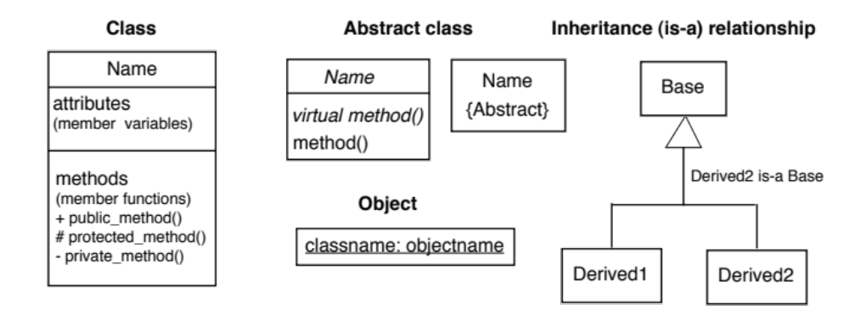
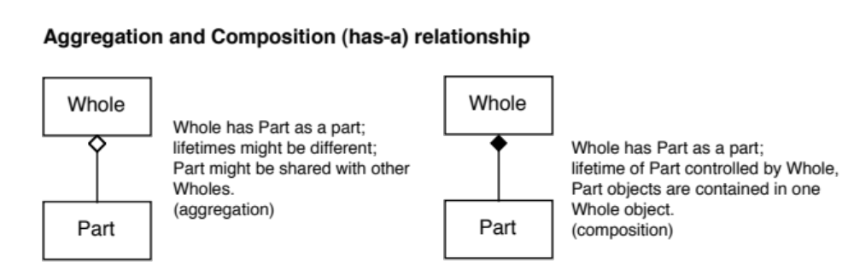
UML notations
objectname:classname

Slide 4
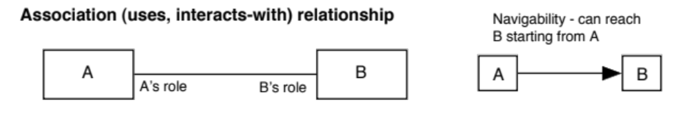
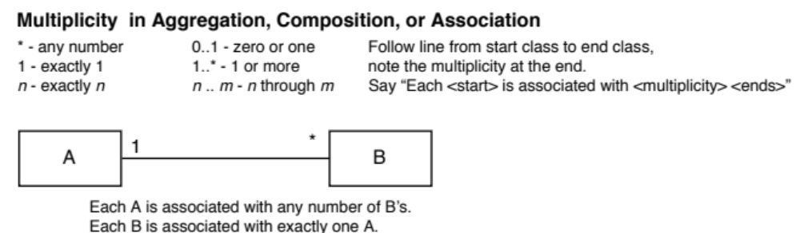
UML notations (contd.)

Slide 5
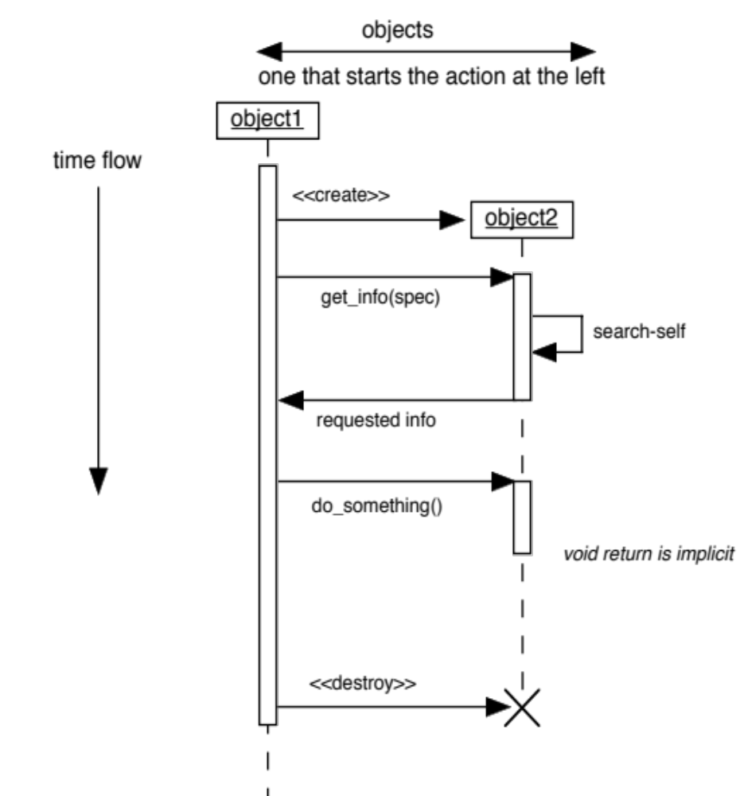
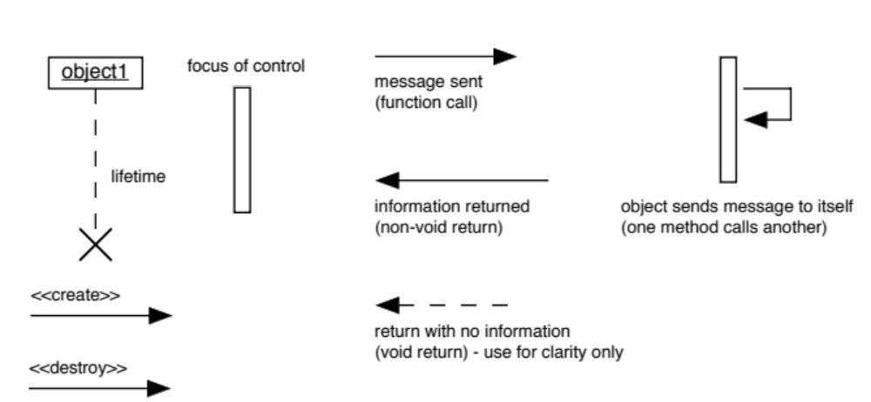
UML notations (contd.)

Slide 6
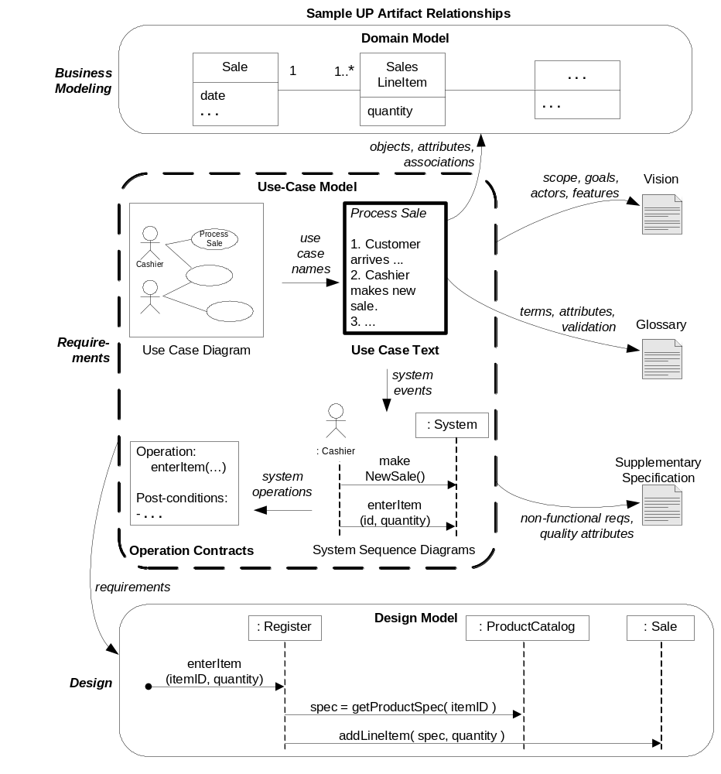
Use Case UML based artifact

Slide 7
Kinds of actors
Primary: primary user, goals are fulfilled using services of the system
Supporting: provides services, external users
Offstage: interest in behavior of use case, but not primary or supporting

Slide 8
Use case formats
Brief: One paragraph summary
  During early requirements gathering
Casual: Informal paragraph
  During early requirements gathering
Fully dressed: All steps, variations, preconditions and success guarantees
  Detailed, structured

Slide 9
Section in a Use case
Scope: bounds the system functionalities
Level:
  User goal level
    Scenarios to fulfill user goal
  Subfunction level
    Sub steps to support user goal
Primary actor
Stakeholders
Assumptions and success guarantees
Alternate flows

Slide 10
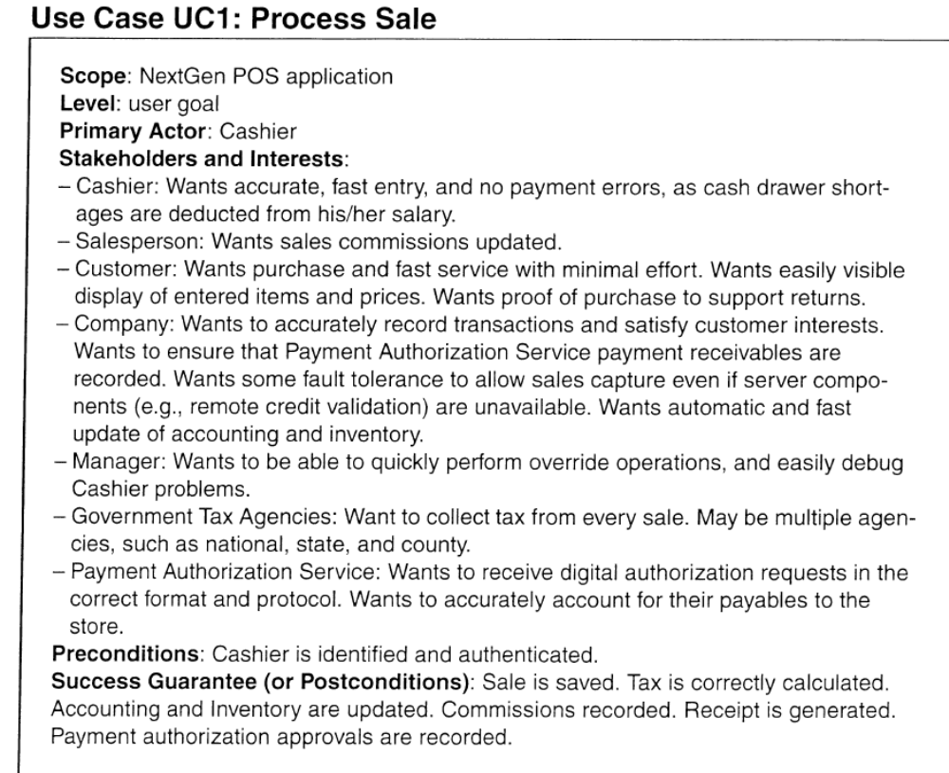

Slide 11
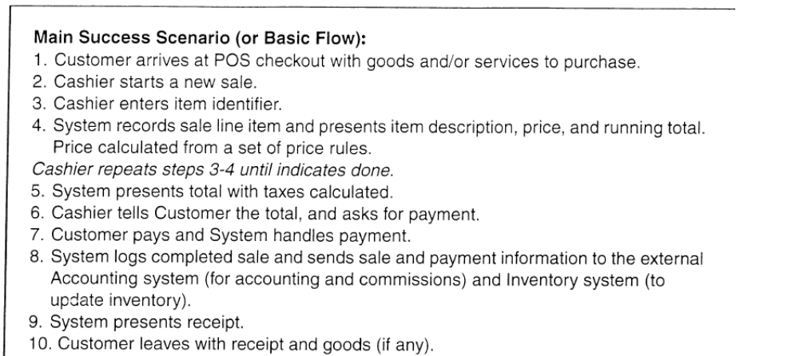

Slide 12
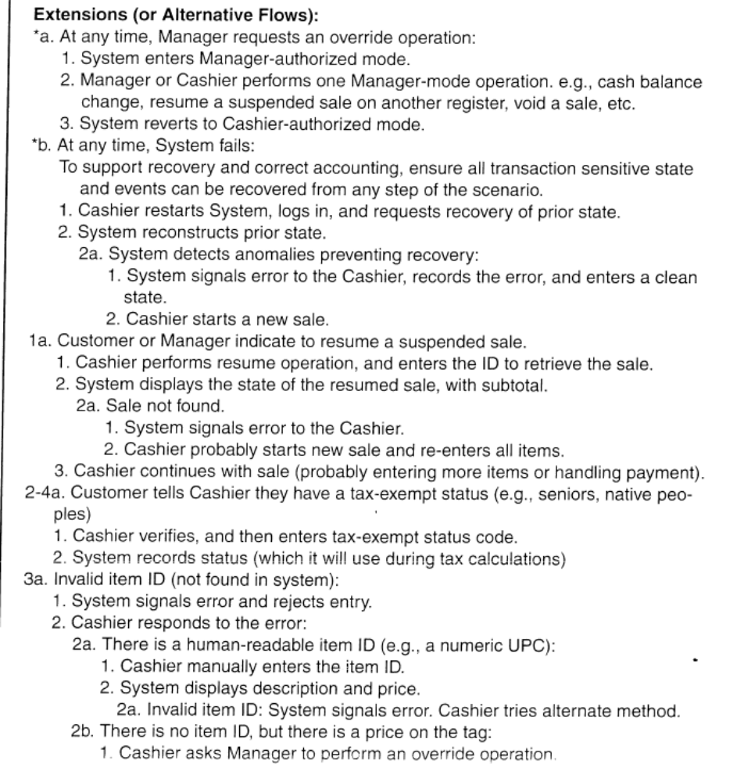

Slide 13
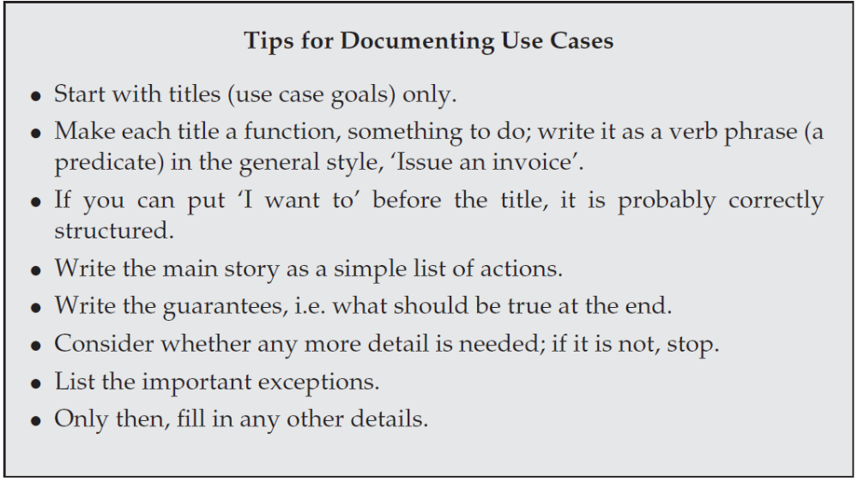
Use Case Tips

Slide 14
Use case writing styles
Avoid concrete User Interface (UI) style in early requirements phase
  Focus on intent, less on UI
Black box use cases are common
  Shows system responsibilities
    OOA/D software elements have responsibilities
    What they do without how they do it

Slide 15
How to define use cases
Identify the scope/system boundary for the system
Identify the primary actors
Identify the goals for each primary actor
Define use cases that satisfy the user goals

Slide 16
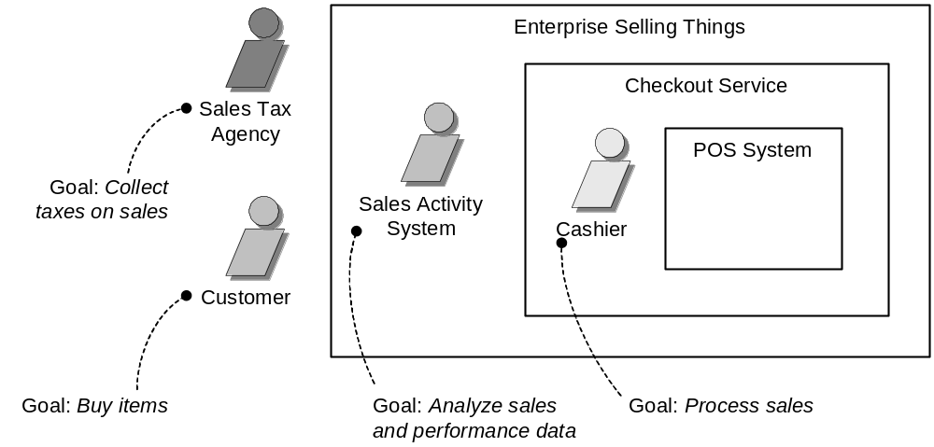
Actors and goals

Slide 17
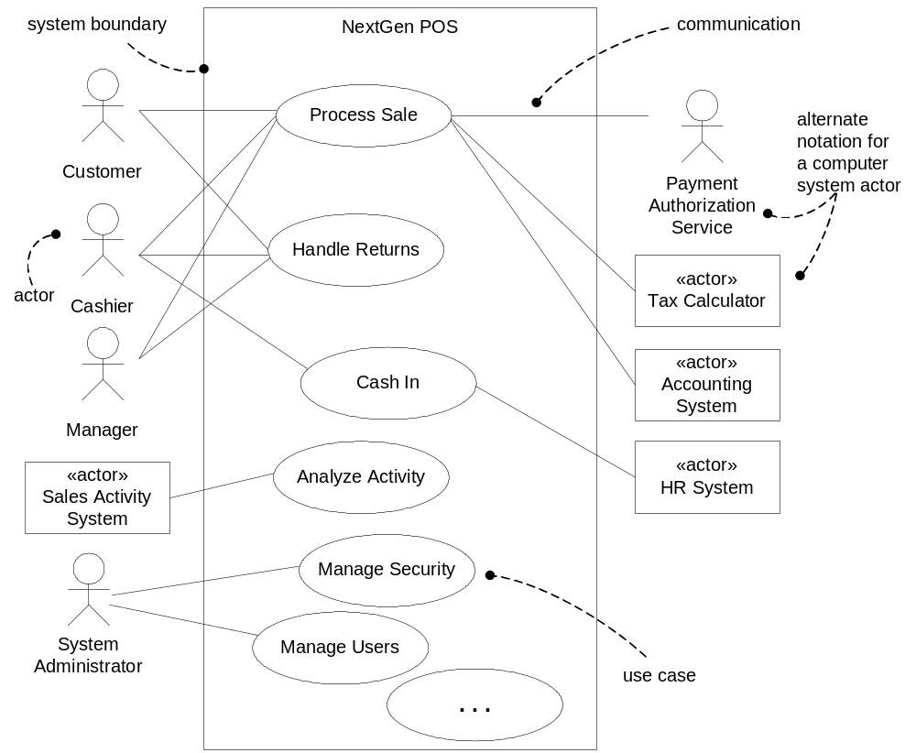
Use case context diagram
Notes:
Context diagram

Slide 18
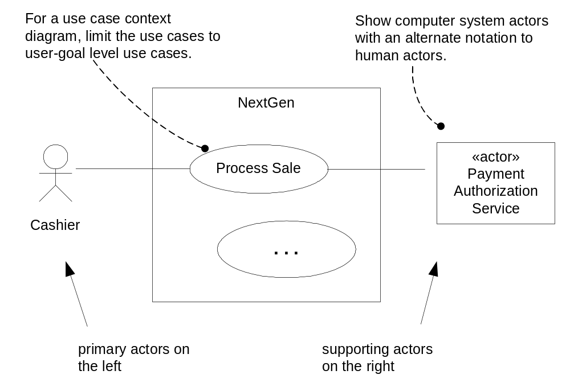
Notations

Slide 19
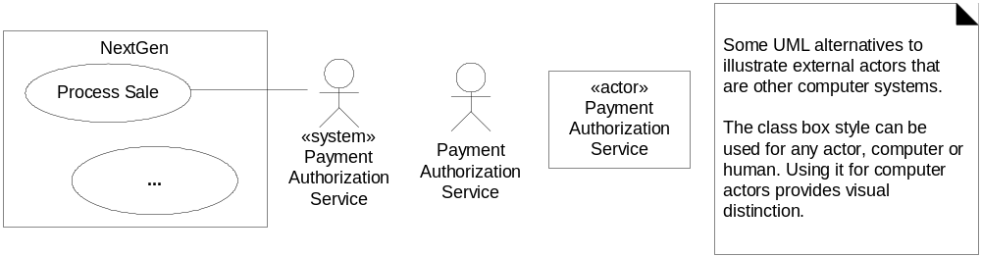
Notation Alternatives

Slide 20
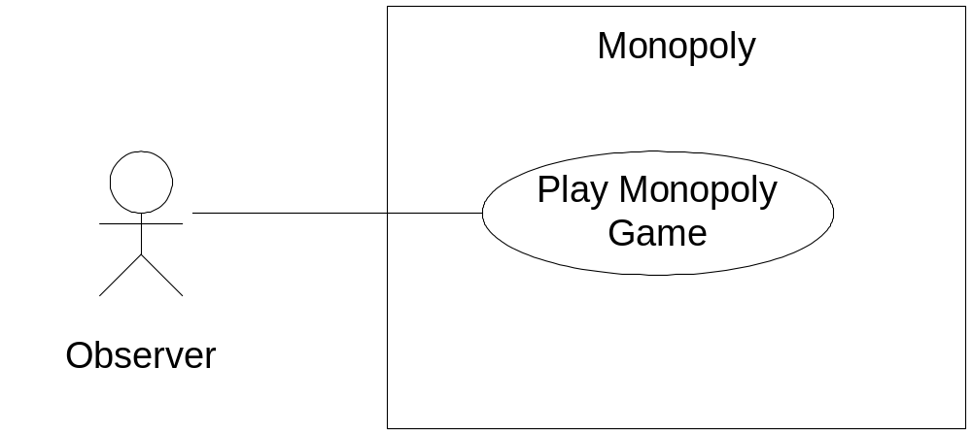
Use Case Diagram for Monopoly Game

Slide 21
Use case write up
Inception
  Identifying the use cases
  Not all written in fully dressed
Elaboration
  Multiple timeboxed iterations
  Majority requirements are identified
Construction
  Timeboxed iterations
  Focus on completing the system

Slide 22
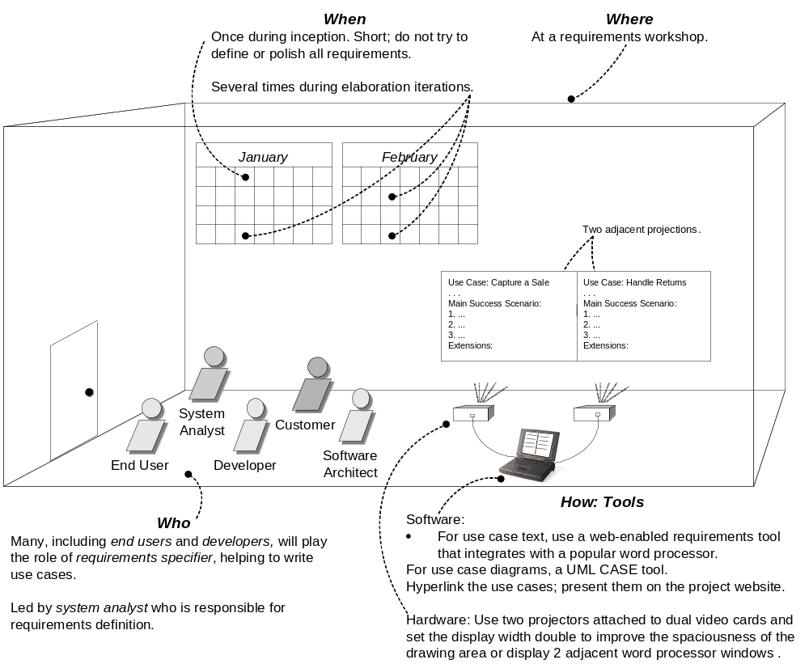
Process and setting context for writing use cases

